Slide 1
Kruskal’s algorithm for MST and
Special Data Structures:
Disjoint Sets
Bibliography: [CLRS] – Chap 23, Chap 21

Slide 2
General algorithm for growing a MST - review
GENERIC-MST
1 A = {};
2 while A does not form a spanning tree
3 find an edge (u,v) that is safe for A
4 A = A + (u,v)
5 return A
Crucial question: How do we find the safe edge needed in line 3 ?

Slide 3
Approaches for growing A
A grows as a single tree Loop invariant: Prior to each iteration, A is a subtree of some minimum spanning tree. (Prim’s algorithm)
A can start as a forest of trees. Loop invariant: Prior to each iteration, A is a subset of some minimum spanning tree. (Kruskal’s algorithm)
8
2
1
7
5
6
7
9
4
3
8
2
1
7
5
6
7
9
4
3

Slide 4
Idea of Kruskal’s Algorithm
Build the MST starting as a forest.
Initially, the trees of the forest are the vertexes of the graph (no edges)
In each step add the edge with the smallest weight that does not create a cycle (we will prove that this is a safe edge)
Continue until the forest is a single tree
This is the minimum spanning tree

Slide 5
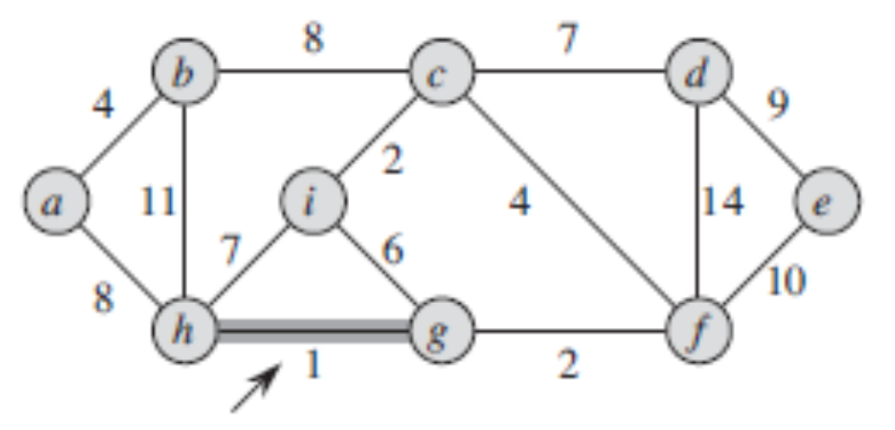
Example
Sorted edges:
(g,h)
(c,i)
(f,g)
(a,b)
(c,f)
(g,i)
(c,d)
(h,i)
(a,h)
(b,c)
(d, e)
(b,h)
(d,f)

Slide 6
Kruskal’s algorithm - outline
MST-KRUSKAL(G=(V,E), w)
A={} (initialize as an empty forest)
for each vertex v in V
  Create-tree(v) and add to forest A
sort the edges of G, E, into increasing order by weight w
for each edge (u,v) in E taken in increasing order by weight
if (TreeOf(u)<>TreeOf(v))
Add (u,v) to A
(The two trees are united now into a new
tree which replaces them in the forest)
return A

Slide 7
Correctness of Kruskal’s algorithm
We need to prove that the edge added in each step (the edge with the smallest weight that does not create a cycle) is a safe edge
Lemma: Let (V,A) be a subgraph of a MST of G=(V,E) and let e=(u,v) in E-A be an edge such that:
(V, A+{e}) has no cycles
E has the minimum weight among all edges in E-A such that cond 1 is satisfied
Then (V, A+{e}) is also a subgraph of the MST containing (V,A).

Slide 8
Proof of the Lemma
Let T be any MST with (V,A) as a subgraph.
If e in T, we are done.
Suppose that e=(u,v) is not in T
There is a unique path from u to v in the MST T, which contains at least one edge e’ in E-A, e’≠e because e not in T but e’ in T
(V, A +{e’}) has no cycles, because it is included in T
weight(e)<=weight(e’) because e was selected according to condition (2) of lemma
Consider the new tree T’=T+{e}-{e’}
If weight(e)=weight(e’) then T’ is another MST
If weight(e)<weight(e’) then weight(T) >weight(T’), but T is the MST, contradiction. Results that the supposition e is not in T is false => e is in T

Slide 9
Kruskal’s algorithm - outline
MST-KRUSKAL(G=(V,E), w)
A={} (initialize as an empty forest)
for each vertex v in V
  Create-tree(v) and add to forest A
sort the edges of G, E, into increasing order by weight w
for each edge (u,v) in E taken in increasing order by weight
if (TreeOf(u)<>TreeOf(v))
Add (u,v) to A
(The two trees are united now into a new
tree which replaces them in the forest)
return A
Questions for an efficient implementation:
  How to represent the forest of trees ?
  How to test whether u,v are in the same tree or not ?
  How to replace two trees of the forest by their union ?

Slide 10
Kruskal’s algo - Implementation
Questions:
  How to represent the forest of trees ?
  How to test efficiently whether u,v are in the same tree or not ?
  How to replace two trees of the forest by their union ?
Solution: use an efficient implem of Disjoint-sets
We have a collection of disjoint sets that supports following 3 operations:
  Make-Set(u)
  Find-Set(u)
  Union(u,v)

Slide 11
Kruskal’s algorithm
KRUSKAL (G=(V,E),w)
A = 0;
for each vertex v in V
MAKE-SET(v)
sort the edges E of G into nondecreasing order by weight w
for each (u,v) // taken from the sorted list
if FIND-SET(u)<>FIND-SET(v)
A = A + { (u,v)}
UNION (u,v)
return A

Slide 12
Kruskal’s algorithm - Analysis
KRUSKAL (G=(V,E),w)
A = 0;
for each vertex v in V
MAKE-SET(v)
sort the edges E of G into nondecreasing order by weight w
for each (u,v) // taken from the sorted list
if FIND-SET(u)<>FIND-SET(v)
A = A + {(u,v)}
UNION (u,v)
return A
A number of |V| calls of MAKE-SET
Sorting can be done in |E| * log (|E|)
O(|E|) calls of FIND-SET and UNION
The performace of Kruskal’s algorithm is given by
the performance of the Union-Find operations !

Slide 13
Disjoint sets
Also known as “union-find.”
Maintain collection S ={S1;…; Sk} of disjoint dynamic (changing over time) sets.
Each set is identified by a representative, which is some member of the set. Doesn’t matter which member is the representative, as long as if we ask for the representative twice without modifying the set, we get the same answer both times.

Slide 14
Operations
MAKE-SET(x): make a new set Si ={x}, and add Si to S.
UNION(x; y) : makes a new set from the union of set members of Sx and Sy
  Representative of new set is any member of Sx or Sy, often the representative of one of Sx and Sy.
  The Union operation destroys Sx and Sy (since sets must be disjoint).
FIND-SET(x): return representative of set containing x.

Slide 15
Disjoint sets - Implementation with linked lists
Each set is a singly linked list, represented by an object with attributes
  head: the first element in the list, assumed to be the set’s representative, and
  tail: the last element in the list.
Objects may appear within the list in any order.
Each object in the list has attributes for
  the set member,
  pointer to the set object, and
  next.

Slide 16
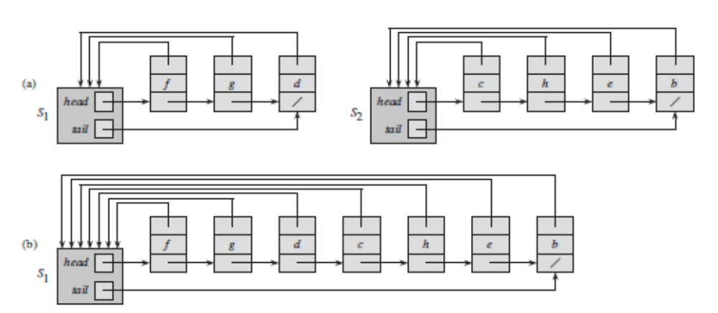
Disjoint sets - Implementation with linked lists
[CLRS – fig 21.2]

Slide 17
Implementing disjoint-sets operations
MAKE-SET(x): create a new linked list whose only object is x.
FIND-SET(x): follow the pointer from x back to its set object and then return the member in the object that head points to.
UNION(x; y) : we can append y’s list onto the end of x’s list. The representative of x’s list becomes the representative of the resulting set. We use the tail pointer for x’s list to quickly find where to append y’s list. Drawback: we must update the pointer to the set object for each object originally on y’s list, which takes time linear in the length of y’s list.

Slide 18
Weighted-Union on lists
To improve the situation of UNION, we will always append the shorter list at the end of the longer list - weighted-union heuristic
Implementation: each list also includes the length of the list (which we can easily maintain) and we always append the shorter list onto the longer
Analysis:
  A single UNION operation can take O(n) time if both sets have n members.
  But how much takes a sequence of m MAKE-SET, UNION, and FIND-SET operations, n of which are MAKE-SET operations ?

Slide 19
Weighted Union Analysis
Theorem
With weighted union, a sequence of m operations on n elements takes O(m + n lg n) time.
Sketch of proof
Each MAKESET and FIND-SET operation takes O(1) time, and there are O(m) of them
For UNION: we count how many times can each object’s representative pointer be updated? It must be in the smaller set each time.
Since the largest set has at most n members, The total time spent updating object pointers over all n UNION operations is O.(n lg n).(=> see proof on next slide)

Slide 20
Weighted Union Analysis - Detail
For UNION: we count how many times can each object’s representative pointer be updated?
Consider a particular object x. We know that each time x’s pointer was updated, x must have started in the smaller set.
  The first time x’s pointer was updated, the resulting set had at least 2 members.
  The next time x’s pointer was updated, the resulting set had at least 4 members.
  The third time x’s pointer was updated, the resulting set had at least 8 members
  After x’s pointer has been updated k times, the resulting set must have at least 2^k members
  Finally, the set will have n members. It’s object representative pointer was updated log n times
  Thus the total time spent updating object pointers over all UNION operations is O(.n * lg n)

Slide 21
Disjoint-sets with linked lists and weighted-union heuristic
Upper bounds for every single operation:
  MAKE-SET(x): O(1)
  FIND-SET(x): O(1)
  UNION(x; y) : O(n)
But: a sequence of n UNION operations in order to build the maximum possible set of n elements takes O(n lg n) time.
Amortized analysis: UNION is an average of O(log n) in this case

Slide 22
Amortized analysis
In an amortized analysis, we average the time required to perform a sequence of data-structure operations over all the operations performed.
With amortized analysis, we can show that the average cost of an operation is small, if we average over a sequence of operations, even though a single operation within the sequence might be expensive.

Slide 23
Kruskal’s algorithm - Analysis
KRUSKAL (G=(V,E),w)
A = 0;
for each vertex v in V
MAKE-SET(v)
sort the edges E of G into nondecreasing order by weight w
for each (u,v); // taken from the sorted list
if FIND-SET(u)<>FIND-SET(v)
A = A + {(u,v)}
UNION (u,v)
return A
|V|<=|E|<=|V|²
O(1)
A number of |V| calls of MAKE-SET
Sorting can be done in |E| * log (|E|)
O(1)
O(|E|) calls of FIND-SET and
O(|V|) calls of UNION
O(V * log (V))
Union-Find implemented with linked lists and weighted union

Slide 24
Kruskal’s algorithm - analysis
If using Union-Find implemented with linked lists and weighted union, the complexity of Kruskal’s algorithm is O(E*log E)
Actually, O(E*log E)=O(E*log V) (because E<=V²)
The complexity is given by the sorting of edges
There are also better implementations of Union-Find (with Forests), but the implementation with linked lists and weighted union is sufficient for Kruskal’s algorithm
An implementation of Union-Find with arrays would be not OK for Kruskal’s algorithm, since it exceeds the complexity of the sorting !

Slide 25
Disjoint sets - Implementation as a forest
Disjoint sets can be implemented as a forest of up-trees
An up-tree: a set of nodes, every node has a parent, there is one node (the root) which has no parent. The root is the representative of the set.
A
I
B
C
D
J
K
E
F
G
H

Slide 26
Implementing disjoint-sets operations
MAKE-SET(x): Initialize node as root O(1)
FIND-SET(x): walk upwards in the tree, starting from x, following parent links, until arriving at the root (height of tree should be small !) O(h)
UNION(x; y) : One tree becomes a subtree of the other. O(1)
A
B
C
D
I
E
F
G
H
J
K

Slide 27
Heuristics to improve Union-Find
In order to reduce the height of the trees, following heuristics can be used:
Union by rank:
  in UNION, always make the root of the smaller tree (smaller height) a child of the root of the larger tree.
Path compression:
  Find path = the path formed by nodes visited during FIND-SET on the trip to the root.
  Make all nodes on the find path direct children of root.

Slide 28
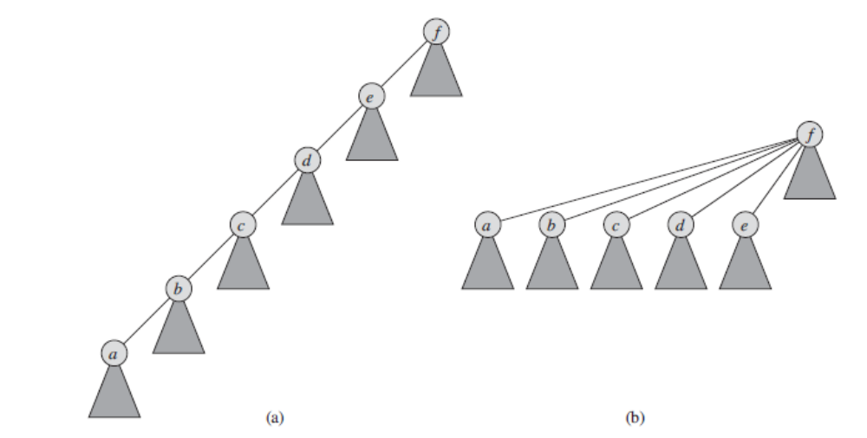
Find-set with path compression
Before executing
FIND-SET(a)
After executing
FIND-SET(a)

Slide 29
Implementation of the forest
Implementations based on dynamic memory allocation are possible, but not needed.
The forest can be implemented with an array
1 2 3 4 5 6 7 8 9 10 11
3 2
rank
1 1 1 1 2 4 4 4 9 9 9
p
A B C D E F G H I J K

Slide 30
Disjoint-sets operations with forest
MAKE-SET(x)
x.p = x
x.Rank = 0
UNION(x; y)
LINK (FIND-SET(x), FIND-SET(y))
LINK.(x; y)
if x.rank > y.rank
y.p = x
else x.p = y
// If equal ranks, choose y as parent and increment its rank.
if x.rank == y.rank
y.rank = y.rank + 1
FIND-SET(x)
  if x <> x.p
  x.p = FIND-SET(x.p)
  return x.p
Union by rank
Path compression

Slide 31
Analysis
Theorem: A sequence of m MAKE-SET, UNION, and FIND-SET operations, n of which are MAKE-SET operations, can be performed on a disjoint-set forest with union by rank and path compression in worst-case time O(m * alfa (n))
Alfa(n) is a very slowly growing function, it leads to almost linear O(m)
The proof (by amortized analysis) in this case exceeds the scope of our lecture (it can be found in [CLRS] – chap 21.4)

Slide 32
Summay
Minimum Spanning Trees. Kruskal’s algorithm [CLRS chap 23]
Special data structures allow algorithms to be implemented efficiently
Disjoint sets (Union-find structures) [CLRS chap 21]
Intro to Amortized analysis

